Slide 1
High acceptability and feasibility of same-day antiretroviral therapy services among HIV-positive adolescents in Bangkok, Thailand
Pich Seekaew, MPH
PREVENTION | Thai Red Cross AIDS Research Centre
USAID LINKAGES Program Thailand
Abstract Number: WEAB0104

Slide 2
Authors
Pich Seekaew,¹ Wipaporn Natalie Songtaweesin,^{2,3} Thanyawee Puthanakit,^{2,3} Sorawit Amatavete,¹ Nipat Teeratakulpisarn,¹ Pongsakorn Surapuchong,¹ Somsong Teeratakulpisarn,¹ Tanat Chinbunchorn,¹ Pintip Jomja,¹ Chonthicha Hanaree,¹ Prapaipan Plodgratoke,¹ Chutima Saisaengjan,⁴ Klayduean Singhaseni,¹ Ratchadaporn Meksena,¹ Sutinee Charoenying,⁵ Stephen Mills,⁵ Ravipa Vannakit,⁶ Praphan Phanuphak,¹ Nittaya Phanuphak¹
¹ PREVENTION, Thai Red Cross AIDS Research Centre, Bangkok, Thailand, ² Faculty of Medicine, Chulalongkorn University, Bangkok, Thailand, ³ Center of Excellence in Pediatric Infectious Diseases and Vaccines, Chulalongkorn University, Bangkok, Thailand, ⁴South East Asia Research Collaboration in HIV, Thai Red Cross AIDS Research Centre, Bangkok, Thailand, ⁵ FHI 360 and LINKAGES, Bangkok, Thailand, ⁶ Office of Public Health, USAID Regional Development Mission Asia, Bangkok, Thailand

Slide 3
Outline
Background and Objectives
Primary Outcomes
Program Design
Results
Conclusions
Future Directions

Slide 4
HIV Epidemiology in Adolescents (2017)
1,770,000 adolescents living with HIV in the world
256,000 new infections
61,000 adolescents living with HIV in East Asia and the Pacific
16,800 new infections
Source: https://data.unicef.org

Slide 5
Treatment Cascade Among Adolescents Living with HIV (ages 15-24)
Source: NAP web report, National Heath Security Office (NHSO), accessed on: October 27, 2017

Slide 6
Contributing Factors
No age-appropriate services
Low sexual health and HIV knowledge
Fragmented and uncoordinated referral system between testing and treating sites
Multiple unnecessary preparatory visits
Stigma

Slide 7
Objectives
Describe Same-Day ART initiation and referral model
Assess the feasibility and safety of Same-Day ART among adolescents

Slide 8
Primary Outcomes
Observational cohort study from July 2017 to April 2019:
Acceptability
Baseline laboratory results
ART initiation rate
Retention at months 3, 6, and 12
Viral load testing and suppression

Slide 9
ART Initiation Hub Model

Slide 10
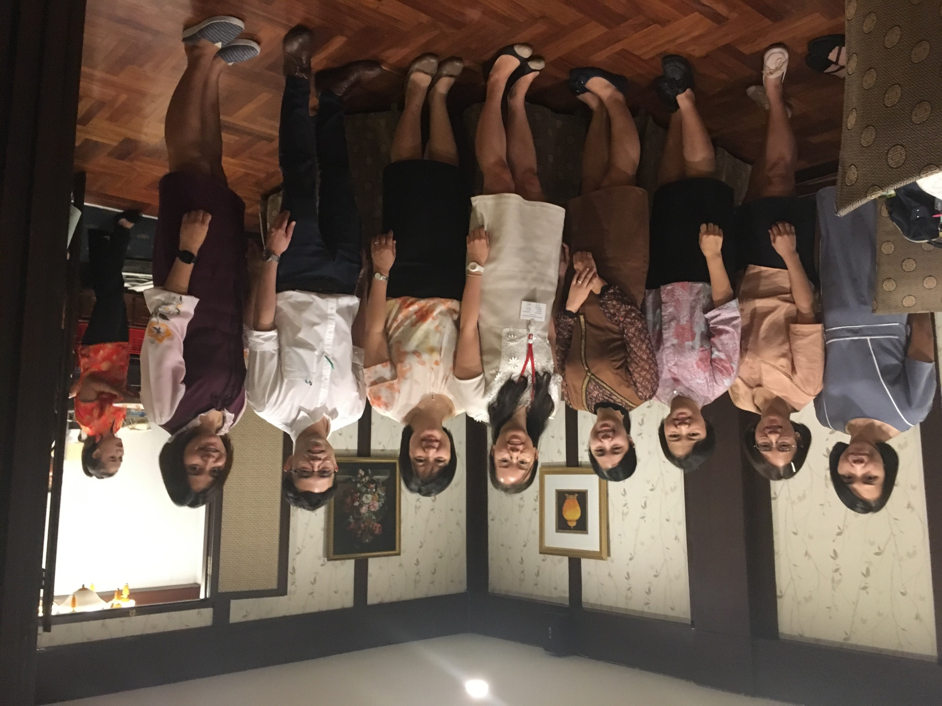
Center of Excellence for Pediatric Infectious Diseases and Vaccines at Chulalongkorn University
Started collaboration in March 2018
Staff:
Pediatric ID physicians
Social workers
Pediatric clinical psychologists
Research nurses
Services:
Prevention and treatment for pediatric and adolescent HIV and STIs
Linkage to related care, including: mental health, substance misuse, sexual and reproductive health, counseling, peer support, legal and financial support

Slide 11
HIV Treatment Algorithm
ART drug regimen:
FTC/TDF + EFV (400mg)
Baseline tests:
Creatinine
Urinalysis
CD4 count
HBsAg
Anti-HCV
Syphilis serology
ALT
Chest X-Ray
Cryptococcal Ag (CD<100 cells/mm³)

Slide 12
Eligibility Criteria
Willing to start ART (non-coercive)
ART naïve
Able to come back for follow-up visit(s)
Results from symptomatic screening/chest X-ray/Gene Xpert MTB/RIF not indicative of tuberculosis
Results from symptomatic screening/cryptococcal antigen test not indicative of cryptococcal meningitis
Symptomatic screening not indicative of serious opportunistic infections that would likely require hospital admissions

Slide 13
Treatment Cascade

Slide 14
Age
P-value = 0.333

Slide 15
Acceptability Stratified By Population
P-value = 0.021

Slide 16
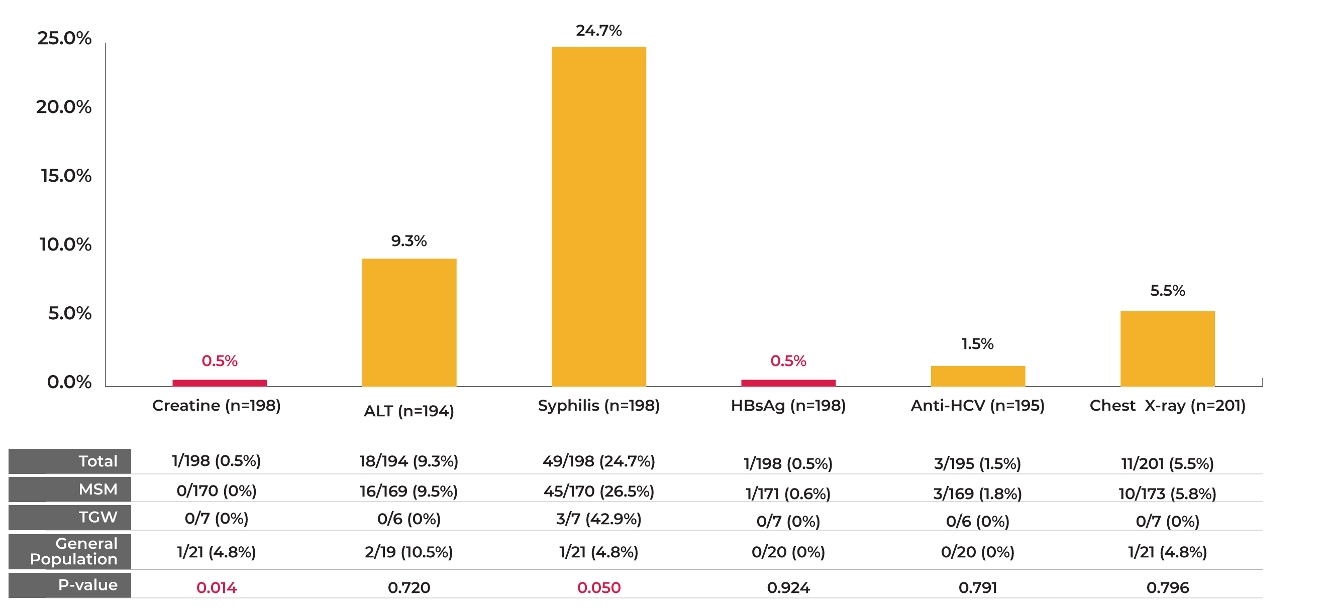
Abnormal Baseline Laboratory Results

Slide 17
Baseline CD4 Counts
Median (IQR) 310 (243-429)
P-value = 0.434

Slide 18
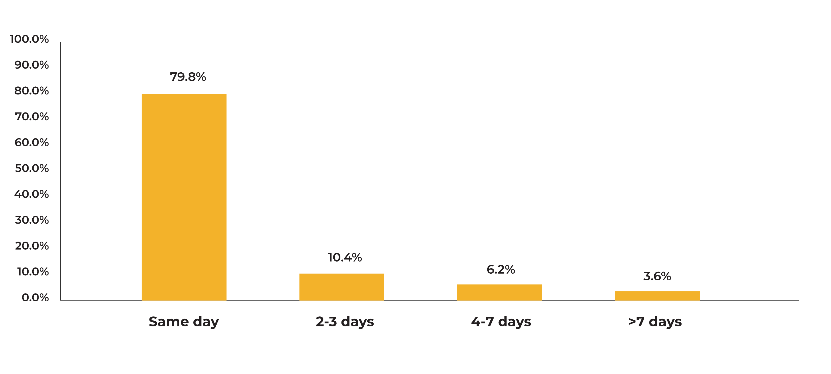
ART Initiation Time Periods

Slide 19
Psychiatric Diagnoses
3 cases were diagnosed with psychiatric symptoms:
Major depressive disorder
Major depressive disorder, anxiety, methamphetamine-induced psychosis
Major depressive disorder, anxiety, post-traumatic stress disorder

Slide 20
Adverse Events and Death
 | Total | MSM | TGW | General Population | p-value
Started ART | 193 | 165 | 7 | 21 | 0.764
AE (no. of persons) | 32 | 28/165 (17%) | 1/7 (14.3%) | 3/21 (14.3%)
Death (no. of persons) | 0 | 0/165 (0%) | 0/7 (0%) | 0/21 (0%)

Slide 21
Adverse Events (total 44 events)

Slide 22
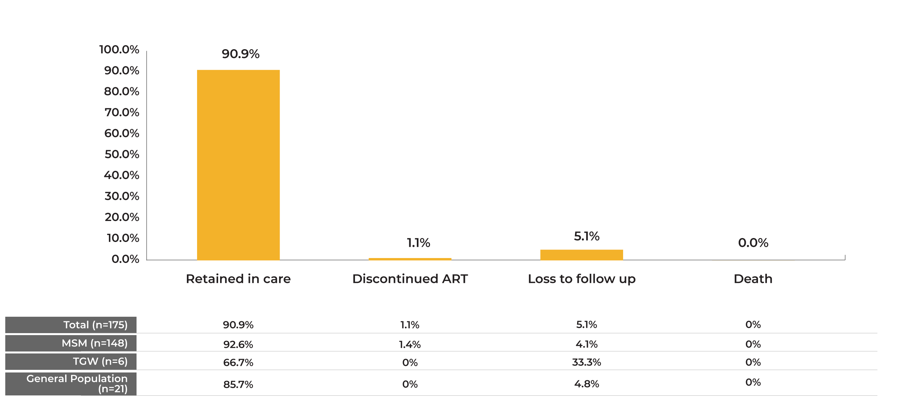
Retention Month 3
P-value= 0.789

Slide 23
Retention Month 6
P-value= 0.947

Slide 24
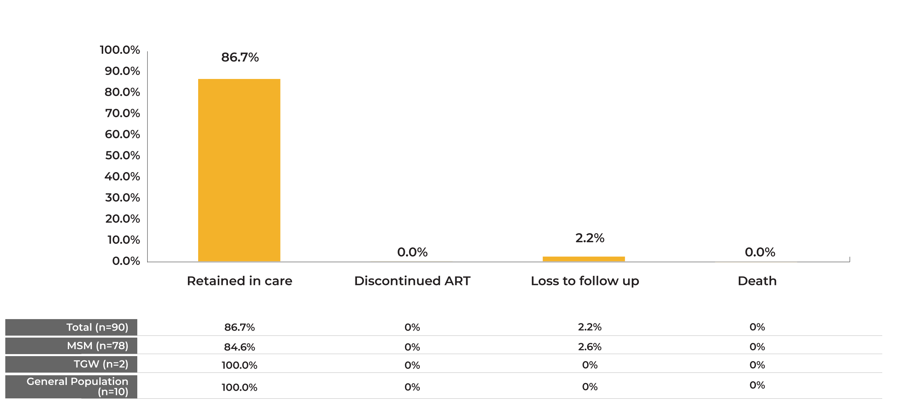
Retention Month 12
P-value= 0.916

Slide 25
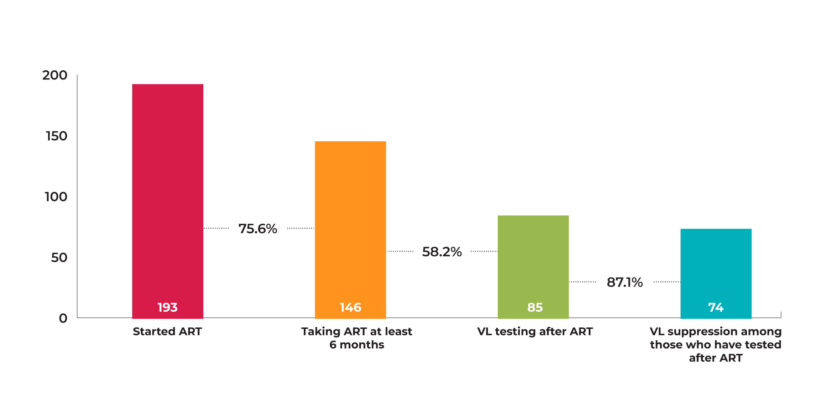
VL Testing and Suppression

Slide 26
Conclusions
Low adverse events leading to discontinuation of ART
Low rates of kidney function abnormalities and hepatitis B co-infection
High rate of syphilis among MSM and TGW adolescents
Low VL testing among clients who have been on ART for at least 6 months
Concerning mental health conditions were found in adolescents living with HIV

Slide 27
Future Directions
Intensify efforts to increase HIV and STI testing among adolescents
Integrate partner notification/index testing service
Recency testing to measure epidemic control

Slide 28
Acknowledgments

